Slide 1
Computer Networks
Lecture 06

Slide 2
Computer Networks
A system of interconnected computers and computerized peripherals such as printers is called computer network.
This interconnection among computers facilitates information sharing among them. Computers may connect to each other by either wired or wireless media.

Slide 3
Computer Network
A set of communication elements connected by communication links
Communication elements
Computers, printers, mobile phones, …
Routers, switches, ...
Communication links
optic fiber
coaxial cable
twisted pair
wireless (radio, microwave, satellite)
Topologies
Ring, Star, Bus, Tree, Mesh
router
workstation
server
mobile
local ISP
regional ISP
company
network

Slide 4
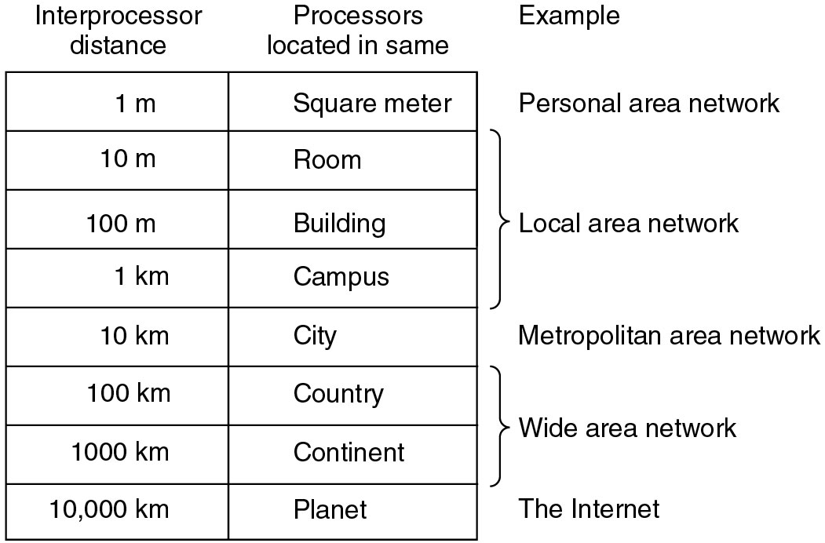
Classification of interconnected processors by scale

Slide 5
Types of Networks
Local Area Network
Wide Area Network
Metropolitan Area Network
Hybrid Network
Personal/Home Area Network
Internetwork
Peer to Peer Networks
Virtual Private Network

Slide 6
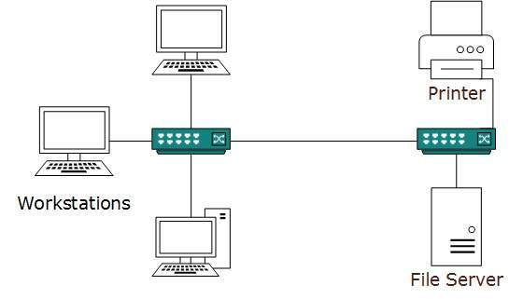
(1) Local Area Networks(LAN)
A computer network spanned inside a building and operated under single administrative system is generally termed as Local Area Network (LAN). Usually, LAN covers an organization’ offices, schools, colleges or universities. Number of systems connected in LAN may vary from as least as two to as much as 16 million.
LAN provides a useful way of sharing the resources between end users. The resources such as printers, file servers, scanners, and internet are easily sharable among computers.
Room, Building, Campus
LAN can be wired, wireless, or in both forms at once.

Slide 7
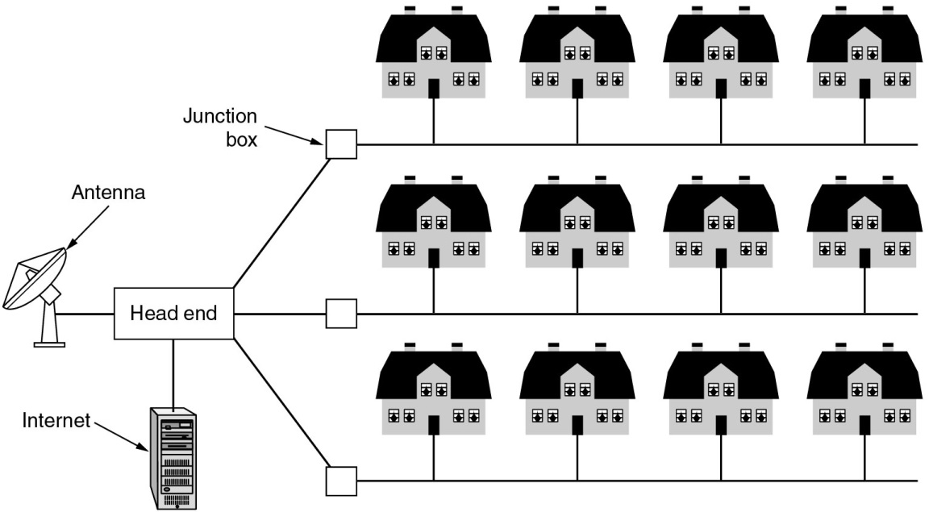
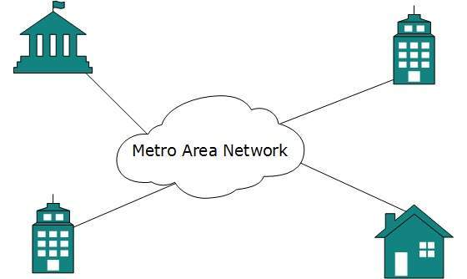
(2) Metropolitan Area Network (MAN)
A metropolitan area network (MAN) is a network that interconnects users with computer resources in a geographic area or region larger than that covered by even a large local area network (LAN) but smaller than the area covered by a wide area network (WAN).
Example: City

Slide 8
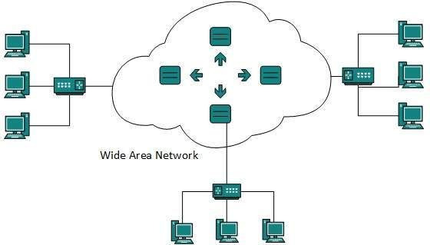
(3) Wide Area Networks (WAN)
A wide area network (WAN) is a network that exists over a large-scale geographical area. A WAN connects different smaller networks, including local area networks (LANs) and metro area networks (MANs). This ensures that computers and users in one location can communicate with computers and users in other locations. WAN implementation can be done either with the help of the public transmission system or a private network.
Example: Country, Continent

Slide 9
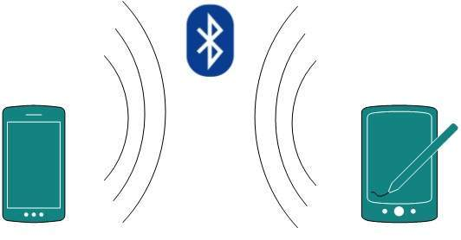
(5) Personal Area Network
A Personal Area Network (PAN) is smallest network which is very personal to a user. This may include Bluetooth enabled devices or infrared enabled devices. PAN has connectivity range up to 10 meters. PAN may include wireless computer keyboard and mouse, Bluetooth enabled headphones, wireless printers and TV remotes.
For example, Piconet is Bluetooth-enabled Personal Area Network which may contain up to 8 devices connected together in a master-slave fashion.

Slide 10
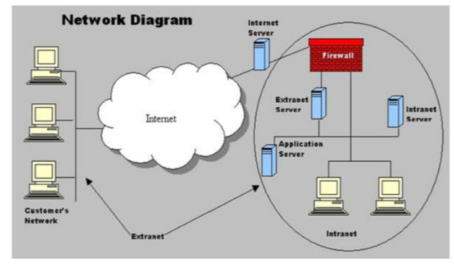
(6) Internetworks
Internet, which has world-wide significance as a network which allows virtually any device to communicate with any other if connected to it.
Intranet is a private computer network that uses Internet Protocol technology to securely share any part of an organization's information or network operating system within that organization.
Extranet is a computer network that allows controlled access from the outside, for specific business or educational purposes.

Slide 11
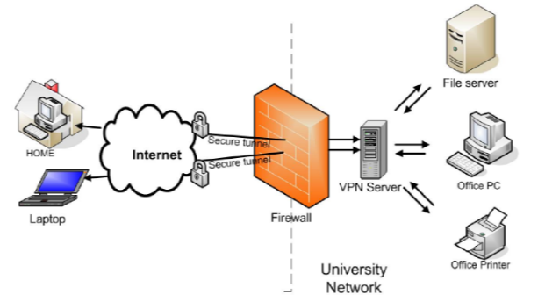

(8) Virtual Private Network (VPN)
VPN (Virtual Private Network) VPN is a private network that can access public networks remotely. VPN uses encryption and security protocols to retain privacy while it accesses outside resources.
When employed on a network, VPN enables an end user to create a virtual tunnel to a remote location. Typically, telecommuters use VPN to log in to their company networks from home.
Authentication is provided to validate the identities of the two peers.
Confidentiality provides encryption of the data to keep it private from prying eyes.
Integrity is used to ensure that the data sent between the two devices or sites has not been tampered with.
Example: Use of FOB Devices for work from home.

Slide 12
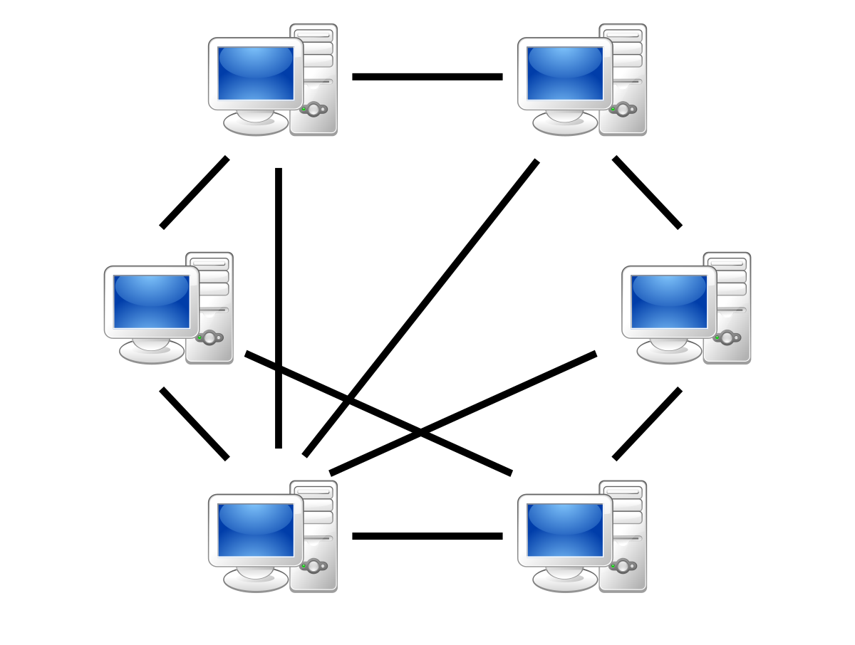
(7) Peer to Peer Networks (P2P)
P2P Stands for "Peer to Peer." In a P2P network, the "peers" are computer systems which are connected to each other via the Internet. Files can be shared directly between systems on the network without the need of a central server. In other words, each computer on a P2P network becomes a file server as well as a client.

Slide 13
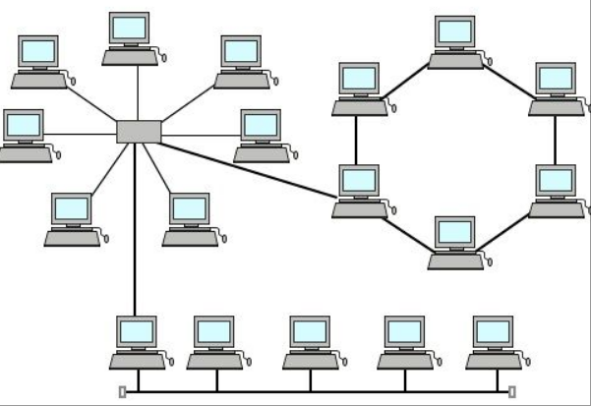
(4) Hybrid Network/ Topology
A hybrid network is any computer network that uses more than one type of connecting technology or topology.
For example, a home network that uses both Wi-Fi and Ethernet cables to connect computers is a hybrid.

Slide 14
Network Topologies

Slide 15
Network Topology
A Network Topology is the arrangement with which computer systems or network devices are connected to each other. Topologies may define both physical and logical aspect of the network. Both logical and physical topologies could be same or different in a same network.

Slide 16
Types of Network Topology
Point-to-Point
Bus Topology
Star Topology
Ring Topology
Mesh Topology
Tree Topology
Daisy Chain Topology
Hybrid Topology

Slide 17

(1) Point-to-Point
Point-to-point networks contains exactly two hosts such as computer, switches or routers, servers connected back to back using a single piece of cable. Often, the receiving end of one host is connected to sending end of the other and vice-versa.
If the hosts are connected point-to-point logically, then may have multiple intermediate devices. But the end hosts are unaware of underlying network and see each other as if they are connected directly.

Slide 18
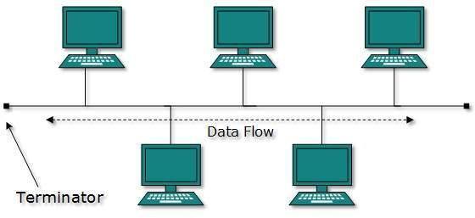
(2) Bus Topology
In case of Bus topology, all devices share single communication line or cable. Bus topology may have problem while multiple hosts sending data at the same time. Therefore, Bus topology either uses CSMA/CD technology or recognizes one host as Bus Master to solve the issue. It is one of the simple forms of networking where a failure of a device does not affect the other devices. But failure of the shared communication line can make all other devices stop functioning.
Both ends of the shared channel have line terminator. The data is sent in only one direction and as soon as it reaches the extreme end, the terminator removes the data from the line.

Slide 19
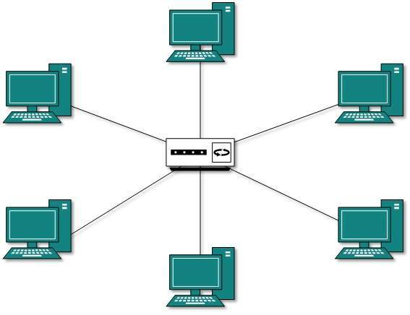
(3) Star Topology
All hosts in Star topology are connected to a central device, known as hub device, using a point-to-point connection. That is, there exists a point to point connection between hosts and hub. The hub device can be any of the following:
Layer-1 device such as hub or repeater
Layer-2 device such as switch or bridge
Layer-3 device such as router or gateway
As in Bus topology, hub acts as single point of failure. If hub fails, connectivity of all hosts to all other hosts fails. Every communication between hosts, takes place through only the hub. Star topology is not expensive as to connect one more host, only one cable is required and configuration is simple.

Slide 20
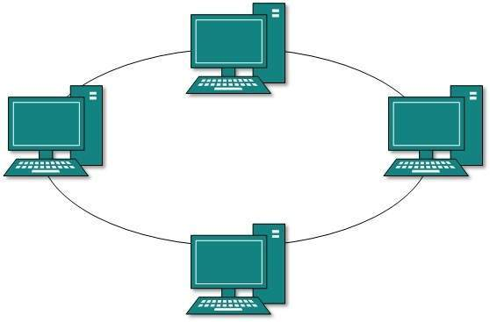
(4) Ring Topology
In ring topology, each host machine connects to exactly two other machines, creating a circular network structure. When one host tries to communicate or send message to a host which is not adjacent to it, the data travels through all intermediate hosts. To connect one more host in the existing structure, the administrator may need only one more extra cable.
Failure of any host results in failure of the whole ring. Thus, every connection in the ring is a point of failure. There are methods which employ one more backup ring.

Slide 21
(5) Mesh Topology
In this type of topology, a host is connected to one or multiple hosts. This topology has hosts in point-to-point connection with every other host or may also have hosts which are in point-to-point connection to few hosts only.
Hosts in Mesh topology also work as relay for other hosts which do not have direct point-to-point links. Mesh technology comes into two types:
Full Mesh: All hosts have a point-to-point connection to every other host in the network. Thus for every new host n(n-1)/2 connections are required. It provides the most reliable network structure among all network topologies.
Partially Mesh: Not all hosts have point-to-point connection to every other host. Hosts connect to each other in some arbitrarily fashion. This topology exists where we need to provide reliability to some hosts out of all.
Example: 5(5-1)/2 = 5(4)/2=20/2=10 lines

Slide 22
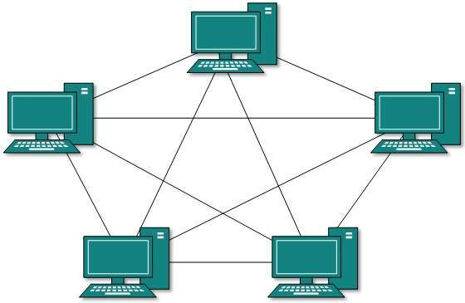
Mesh Topology

Slide 23
(6) Tree Topology
Also known as Hierarchical Topology, this is the most common form of network topology in use presently. This topology imitates as extended Star topology and inherits properties of bus topology.
This topology divides the network in to multiple levels/layers of network. Mainly in LANs, a network is bifurcated into three types of network devices.
The lowermost is access-layer where computers are attached.
The middle layer is known as distribution layer, which works as mediator between upper layer and lower layer.
The highest layer is known as core layer, and is central point of the network, i.e. root of the tree from which all nodes fork.
All neighboring hosts have point-to-point connection between them. Similar to the Bus topology, if the root goes down, then the entire network suffers even though it is not the single point of failure. Every connection serves as point of failure, failing of which divides the network into unreachable segment.

Slide 24
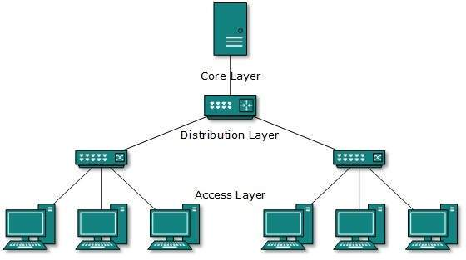
Tree Topology

Slide 25

(7) Daisy Chain
This topology connects all the hosts in a linear fashion. Similar to Ring topology, all hosts are connected to two hosts only, except the end hosts. Means, if the end hosts in daisy chain are connected then it represents Ring topology.
Each link in daisy chain topology represents single point of failure. Every link failure splits the network into two segments. Every intermediate host works as relay for its immediate hosts.

Slide 26
(8) Hybrid Topology
A network structure whose design contains more than one topology is said to be hybrid topology. Hybrid topology inherits merits and demerits of all the incorporating topologies.
The below picture represents an arbitrarily hybrid topology. The combining topologies may contain attributes of Star, Ring, Bus, and Daisy-chain topologies. Most WANs are connected by means of Dual-Ring topology and networks connected to them are mostly Star topology networks. Internet is the best example of largest Hybrid topology

Slide 27
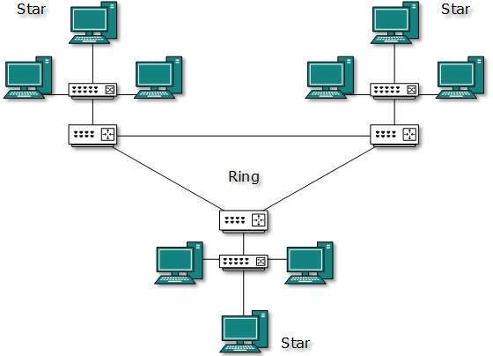
Hybrid Topology

Slide 28
Communication Protocols
Describes the rules that govern the transmission of data over the communication Network.
Provide a method for orderly and efficient exchange of data between the sender and the receiver.

Slide 29
Roles of Communication Protocol
Data Sequencing – to detect loss or duplicate packets.
Data Routing – to find the most efficient path between source and a destination.
Data formatting – defines group of bits within a packet which constitutes data, control, addressing and other information.
Flow control – ensures resource sharing and protection against traffic congestion by regulating the flow of data on communication lines.

Slide 30
TCP/IP Protocols
Internet Protocol(IP)
The Internet Protocol is the principal protocol in the Internet protocol suite for relaying data across networks. Its routing function essentially establishes the internet. The Internet protocol suite is referred as TCP/IP.
Transmission Control Protocol (TCP)
The Transmission Control Protocol is the core protocol of the internet protocol suite. It originated in the network implementation in which it complemented the Internet Protocol. Therefore the entire suite is commonly referred to as TCP/IP. TCP provides reliable delivery of a stream of octets over an IP network. Ordering and error-checking are main characteristics of the TCP. All major Internet applications such as World Wide Web, email and file transfer rely on TCP. Examples, FTP, HTTP

Slide 31
Network Protocols and Ports
S. No | Name | Port | Description
1 | Hypertext Transfer Protocol (HTTP) | 80, 443 | The HTTP is the foundation of data communication for the World Wide Web. The hypertext is structured text that uses hyperlinks between nodes containing texts. The HTTP is the application protocol for distributed and collaborative hypermedia information system.
2 | File Transfer Protocol (FTP) | 20,21 | The FTP is the most common protocol used in the file transferring in the Internet and within private networks.
3 | Secured Shell (SSH) | 22 | SSH is the primary method used to manage the network devices securely at the command level. It usually used as the alternative of the Telnet which does not support secure connections.
4 | Telnet | 23 | Telnet is the primary method used to manage network devices at the command level. Unlike SSH, Telnet does not provide a secure connection, but it provides a basic unsecured connection.
5 | Simple Mail Transfer Protocol (SMTP) | 25 | SMTP is used for two primary functions. It is used to transfer email from source to destination between mail servers and it is used to transfer email from end users to a mail system.
6 | Domain Name System (DNS) | 53 | Domain name system is used to convert the domain name to IP address. There are root servers, TLDs and authoritative servers in the DNS hierarchy.
7 | Post Office Protocol version 3 (POP 3) | 143 | IMAP version 3 is another main protocol that used to retrieve mail from a server. IMAP does not delete the content from the mail box of the server.
8 | Simple Network Management Protocol (SNMP) | 161,162 | The Simple Network Management Protocol is used to manage networks. It has abilities to monitor, configure and control network devices. SNMP traps can also be configured on network devices to notify a central server when specific action are occurring.

